Slide 2
MAN-10081 Teams, People and Performance
M

Slide 3
LECTURE 2 - Leadership

Slide 4
Session Content
Assessment Summary
Quick Recap –
Forming Teams
Belin’s Team Roles
Introduction to Leadership
Group Task!

Slide 5
Assessment Summary
Students are required to produce either a 5–10-minute podcast or a 1500-word written report. This project is a deep reflection on your experiences during the team-based exercises in this module, including collaborative tasks, leadership activities, and problem-solving challenges. The submission must address the following three areas:
Individual role in the team
Team dynamics
Personal development
Submission deadline: 11 May 2026, 1 pm, via KLE

Slide 6
Team Life Cycle Model
Forming
Storming
Norming
Performing
Adjourning / Mourning
Tuckman and Jensen, 1977

Slide 7
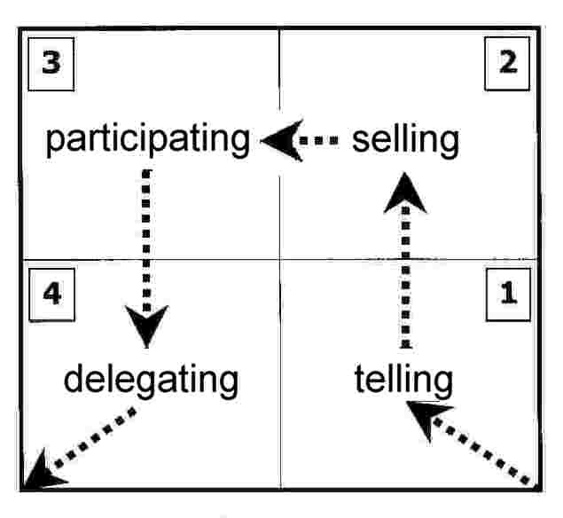
Notes:
Hersey and Blanchard characterized leadership style in terms of the amount of task behavior and relationship behavior that the leader provides to their followers. They categorized all leadership styles into four behavior types, which they named S1 to S4:
S1: Telling – is characterized by one-way communication in which the leader defines the roles of the individual or group and provides the what, how, when, and where to do the task
S2: Selling – while the leader is still providing the direction, he or she is now using two-way communication and providing the socioemotional support that will allow the individual or group being influenced to buy into the process.
S3: Participating – this is now shared decision making about aspects of how the task is accomplished and the leader is providing less task behaviors while maintaining high relationship behavior.
S4: Delegating – the leaders is still involved in decisions; however, the process and responsibility has been passed to the individual or group. The leader stays involved to monitor progress.
Of these, no one style is considered optimal for all leaders to use all the time. Effective leaders need to be flexible, and must adapt themselves according to the situation.

Slide 8
Task: I am about to go through Belbin’s Team roles again, write down which role best describes you and why!!!

Slide 9
Belbin’s Team Roles
Plant
Resource Investigator
Co-ordinator
Monitor Evaluator
Implementer
Shaper
Completer/Finisher
Team worker
Specialist
Plant

Slide 10
The Nine Team Roles! Plant:
Strengths:
Creative, imaginative, unorthodox.
Solves difficult problems
Allowable weaknesses:
ignores details, too pre-occupied to communicate effectively

Slide 11
Resource Investigator:
Strengths:
Extrovert, enthusiastic, communicative.
Explores opportunities; develops contacts
Allowable weaknesses:
Over optimistic.
Loses interest once initial enthusiasm has passed

Slide 12
Co-ordinator:
Strengths:
Mature, confident, a good chair-person.
Clarifies goals, promotes decision making, delegates well
Allowable weaknesses:
Can be seen as manipulative. Delegates personal work

Slide 13
Shaper:
Strengths:
Challenging, dynamic, thrives on pressure.
Has the drive and courage to overcome obstacles
Allowable weaknesses:
Can provoke others.
Tends to hurt people’s
feelings

Slide 14
Monitor Evaluator:
Strengths:
Sober, strategic and discerning.
Sees all options.
Judges accurately
Allowable weaknesses:
Lacks drive and ability
to inspire others.
Overly critical

Slide 15
Team worker:
Strengths:
Co-operative, mild, perceptive and diplomatic.
Listens, builds, averts friction, calms the waters
Allowable weaknesses:
Indecisive in crunch
situations.
Can be easily influenced

Slide 16
Implementer:
Strengths:
Disciplined, reliable, conservative and efficient.
Turns ideas into practical actions
Allowable weaknesses:
Somewhat inflexible.
Slow to respond to new
possibilities

Slide 17
Completer/finisher:
Strengths:
Painstakingly conscientious, anxious.
Searches out errors and omissions.
Delivers on time
Allowable weaknesses:
Inclined to worry unduly.
Reluctant to delegate.
Can be a nit-picker

Slide 18
Specialist:
Strengths:
Single-minded, self-starting, dedicated.
Provides knowledge and skills in short supply
Allowable weaknesses:
Contributes on only a narrow front
Dwells on technicalities
Overlooks the ‘big picture’.

Slide 19
Leadership!

Slide 20
What is Leadership?
Leadership is a set of behaviors used to help people align their collective direction, to execute strategic plans, and to continually renew an organization- Mckinsey & Company, August 17, 2022, https://www.mckinsey.com/featured-insights/mckinsey-explainers/what-is-leadership#/
Leadership is a process of social influence, which maximizes the efforts of others, towards the achievement of a goal- Forbes, https://www.forbes.com/sites/kevinkruse/2013/04/09/what-is-leadership/
Leadership is about empowering others to achieve things they did not think possible. Leadership is about pointing in the direction, articulating a vision of the world that does not yet exist. Then asking help from others to insure that vision happens- Simon Sinek

Slide 21
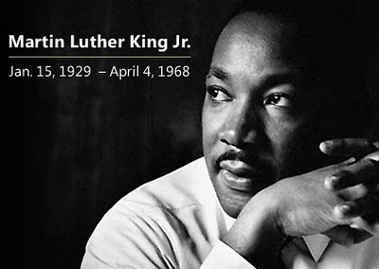
"A genuine leader is not a searcher for consensus but a molder of consensus." - Martin Luther King, Jr.

Slide 22
Types of Leadership Styles
Charismatic Leadership, when leaders uses their charm, magnetism, and emotional appeal to inspire and motivate followers.
Traditional Leadership, is based on the belief that power is bestowed on the leader, in keeping with the traditions of the past
Situational Leadership, A theory of leadership that proposes that leaders change their leadership styles based on who they are leading
Appointed Leadership, select or designated to fill an office or a position
Functional Leadership, Related to team leader theory in that they are just part of the function of the team

Slide 23
The two arguments…
When it comes to leadership there are two opposing arguments:
“Anyone can become a leader. It’s just a skill and can be taught like any other.”
“Leaders are born with special qualities; some people stand out from the crowd. You’ve either got it or you haven’t.”
Charles Handy pg 96

Slide 24
Leaders vs. Managers
“A manager does the right thing whereas a leader does what is right.”
Leader
Visionary, passionate, creative, flexible, inspiring, innovative, courageous, imaginative, experimental, independent, shares knowledge.
Manager
Rational, consulting, persistent, problem solving, tough minded, analytical, structured, deliberate, authoritative, stabilising, centralises knowledge.

Slide 25
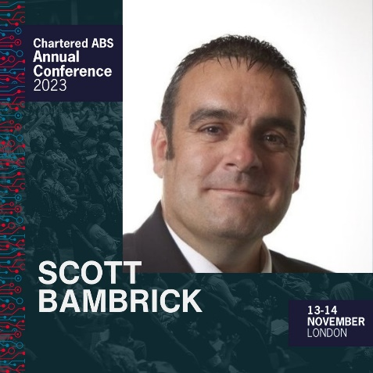
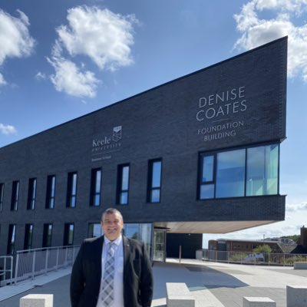
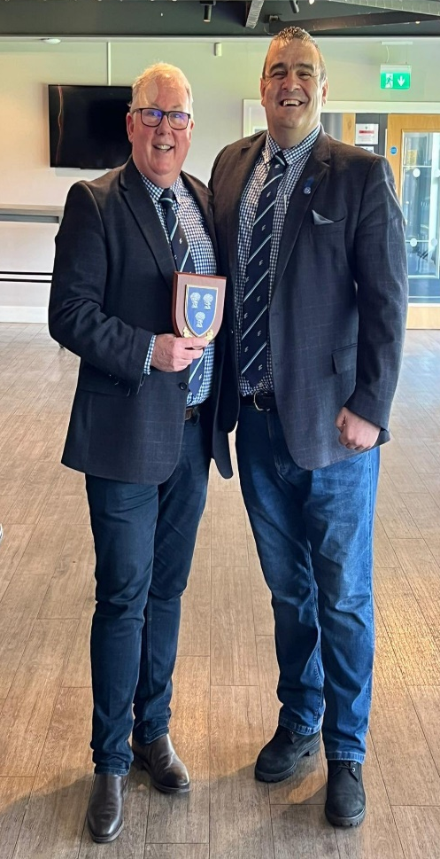
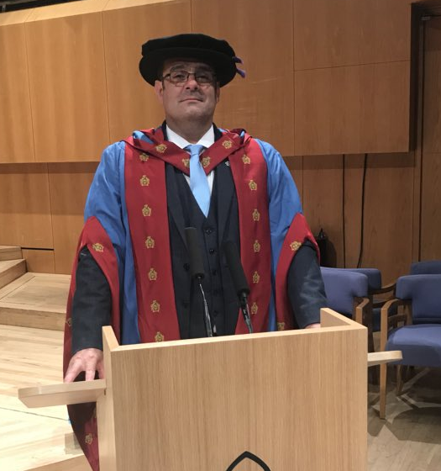
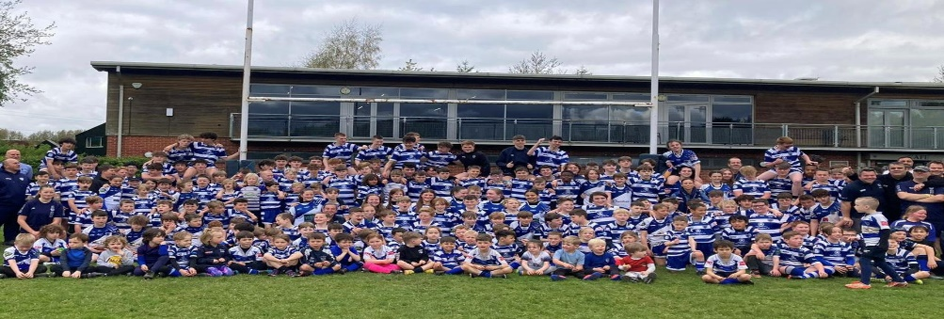
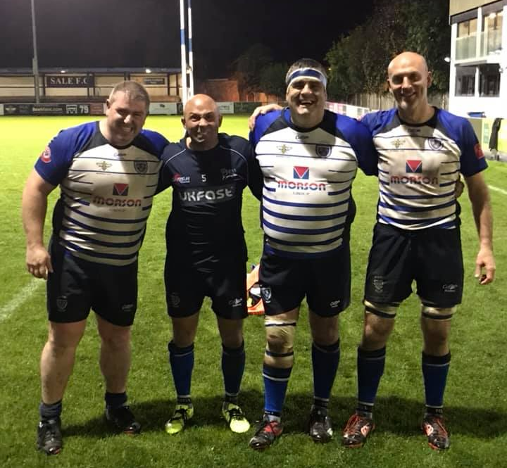
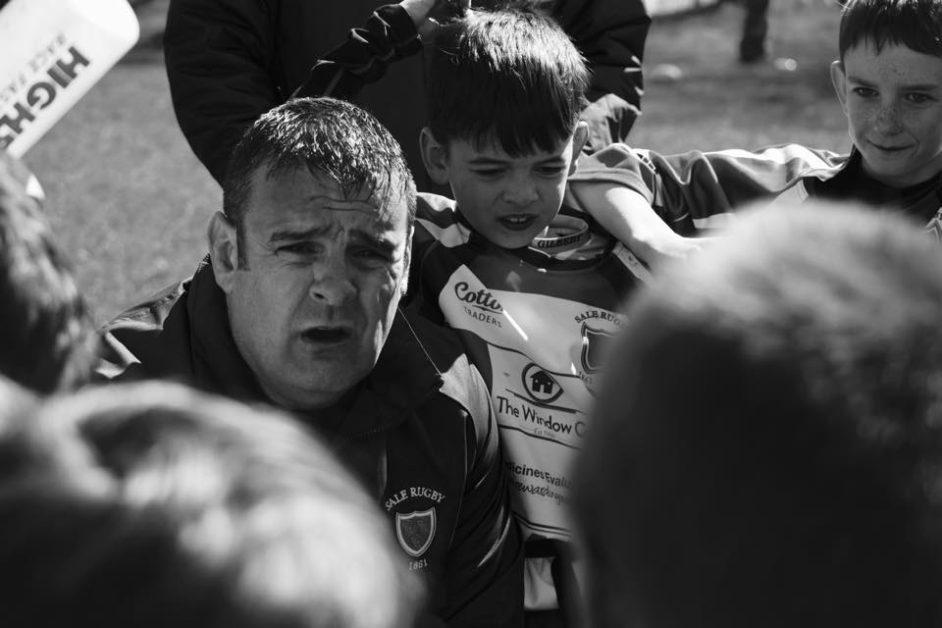
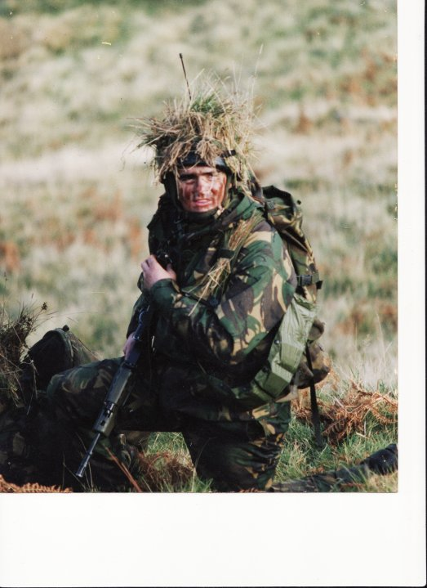
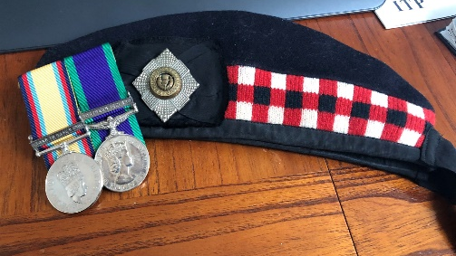
My journey and what type of leader I am.

Slide 26
Some thoughts
Leadership has nothing to do with position/title.
Leadership is the awesome opportunity to see and lift those around us rise up and reach their dreams and ambitions.
What makes a good leader?
Kindness! Treat people how you would like to be treated, it goes a long way when you need them to step up.
Honesty! Always be honest, do not be afraid to have the difficult conversations.
Humility! If you are not humble you are not listening, we have two ears and one mouth, use these in equal proportion.
Leaders need to focus on environment they create.
Leaders are not responsible for results, they are responsible for the people who are responsible for results.
Take care of the people and the environment.
Leadership comes at a cost!
You do not do less work, you do more.
The more work you do is look after others.

Slide 27
In pairs discuss what characteristics you have from each list!
Be ready to share your thoughts with the group!
Leader
Visionary, passionate, creative, flexible, inspiring, innovative, courageous, imaginative, experimental, independent, shares knowledge.
Manager
Rational, consulting, persistent, problem solving, tough minded, analytical, structured, deliberate, authoritative, stabilising, centralises knowledge.

